Slide 1

GuideSense
Your Trusted Navigation Companion
Team: Power Angers
Sprint 2

Slide 2
Agenda
1
2
3
Team Member
6
Designed Diagrams
Project Overview
7
Sprint 1 Recap
8
Product & Sprint 2 backlogs, Matrics
Technologies & Tools, Team Logistics
4
Personas
9
Sprint 3 – Sprint planning
5
MVP
10
Project Demo

Slide 3
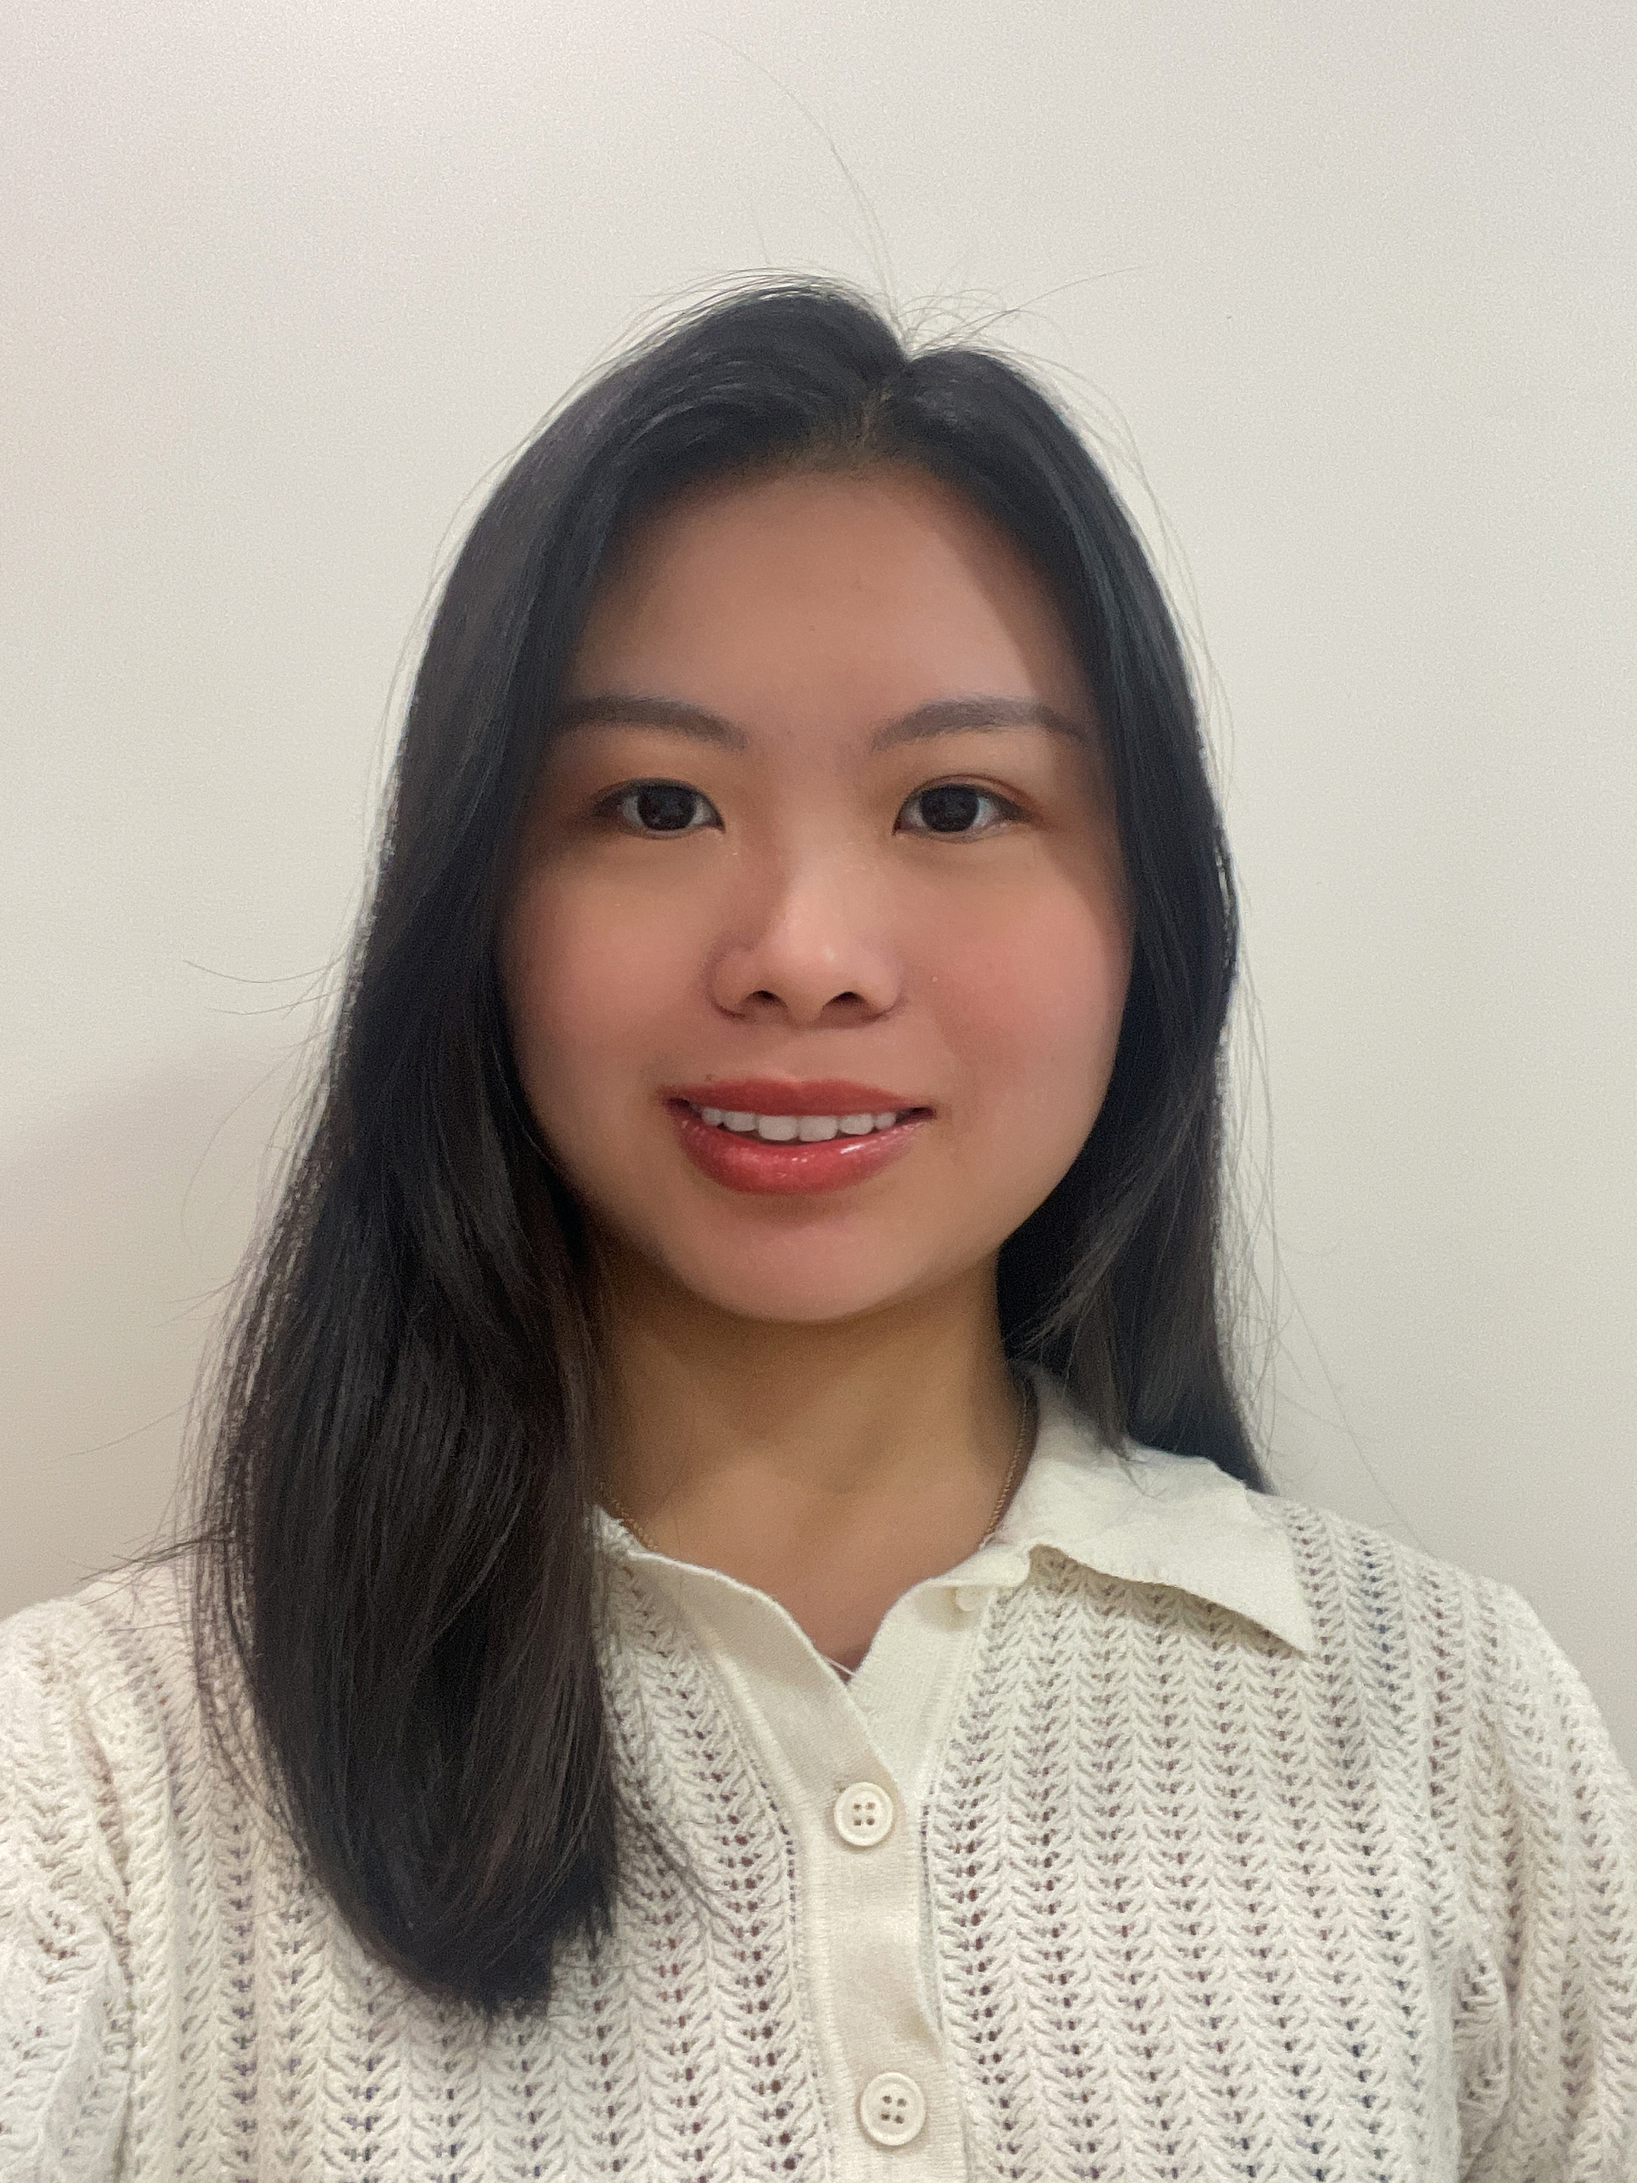

Power Anger
Afziya Waknis
Kaiyin Chen
Project Manager/
Developer
Aw14091n@pace.edu
Database Administrator
Kaiyin.chen@pace.edu

Slide 4
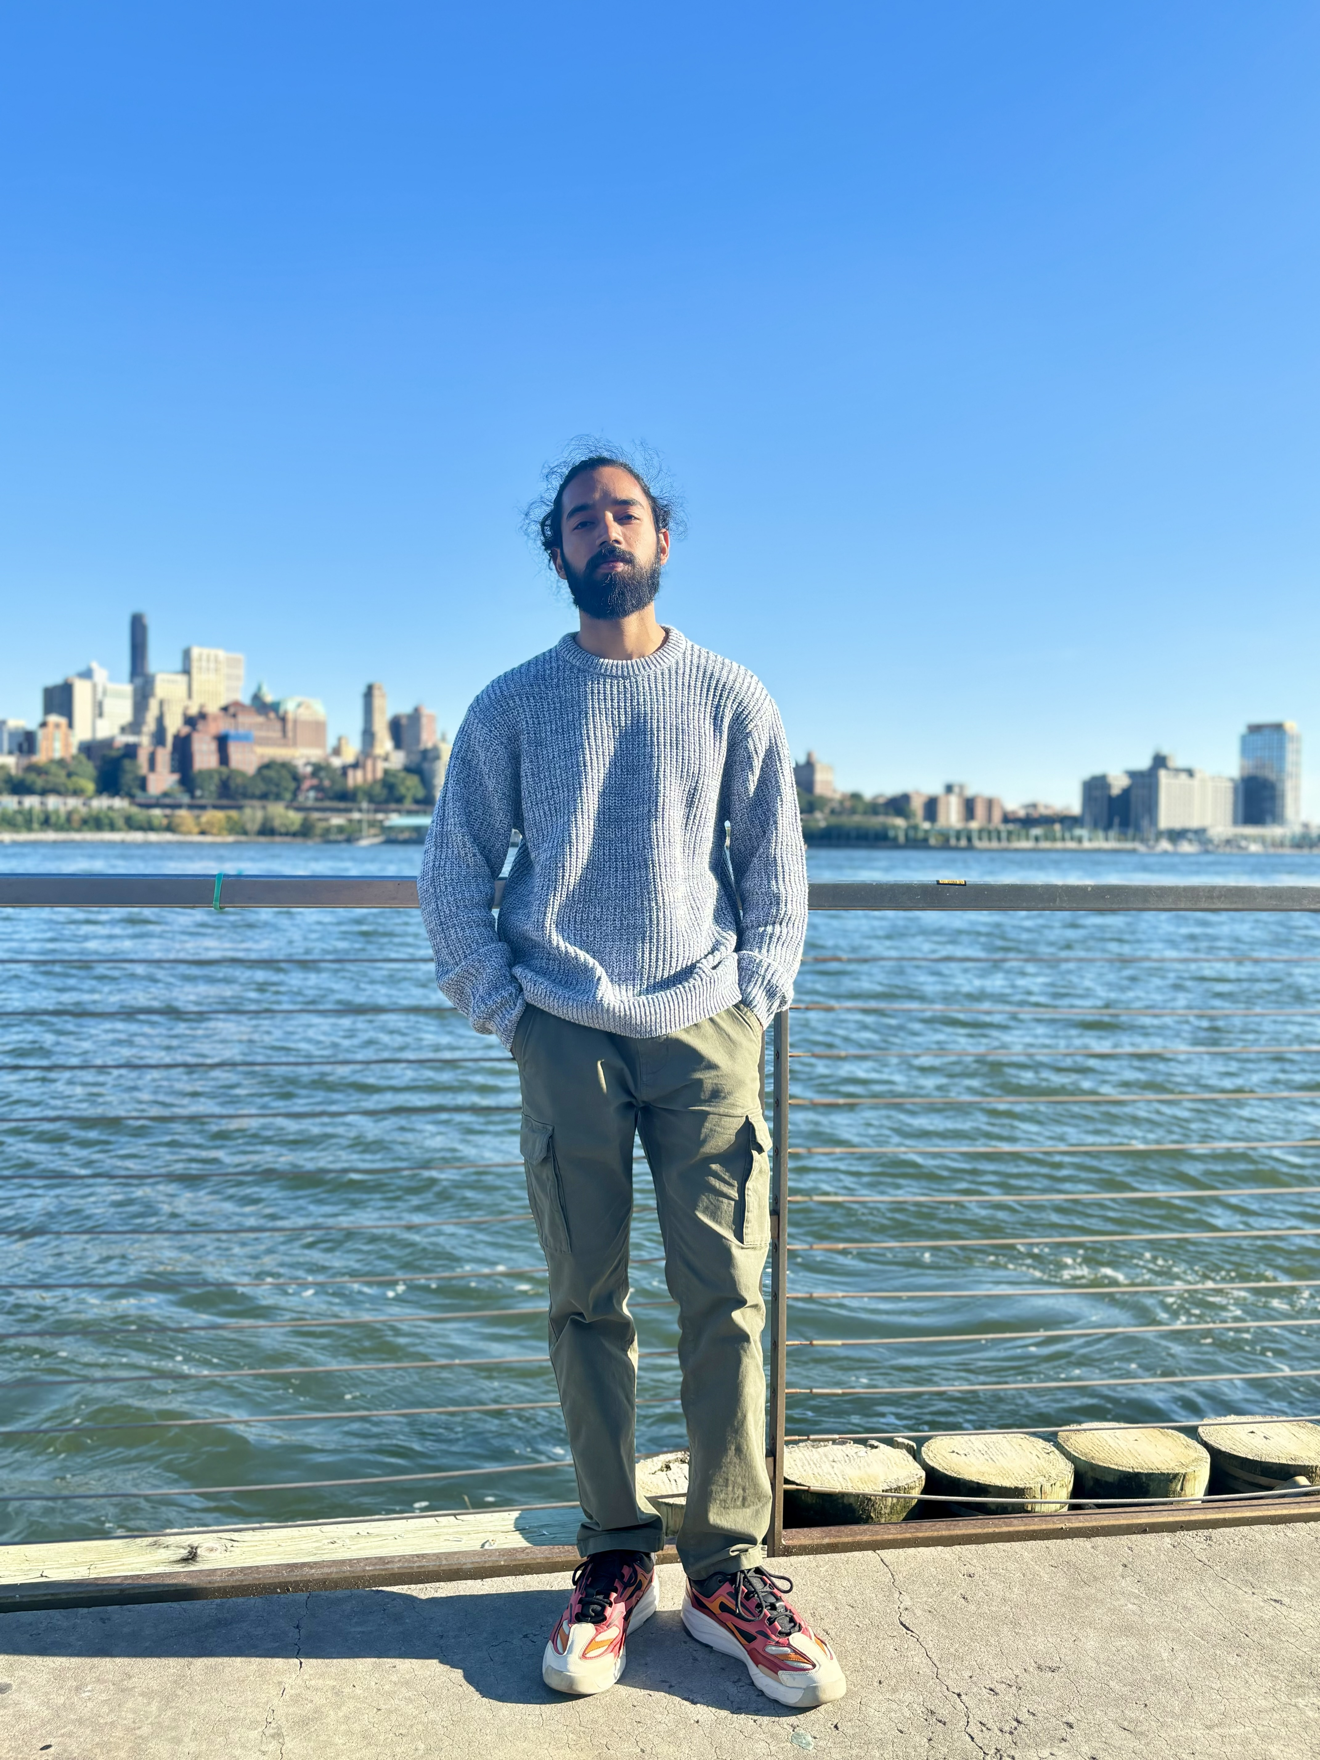

Power Anger
Ritesh Singh
Dinesh Gopi Sunkara
Devops Engineer
Ritesh.singh@pace.edu
Developer
Ds46669n@pace.edu

Slide 5
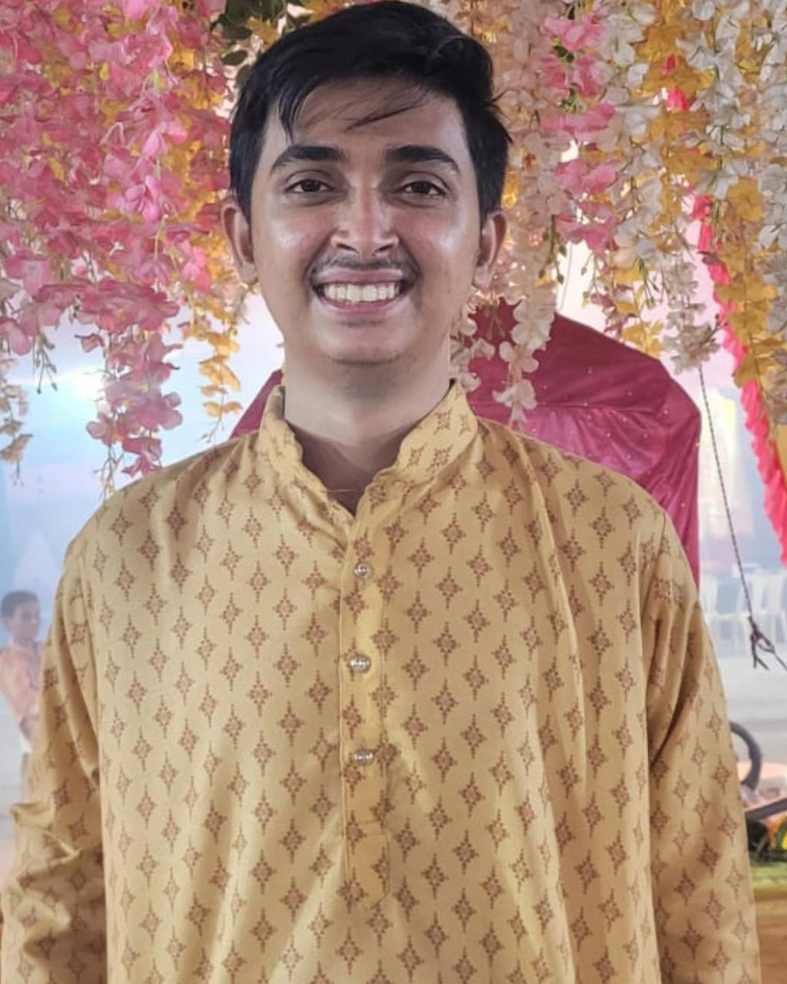
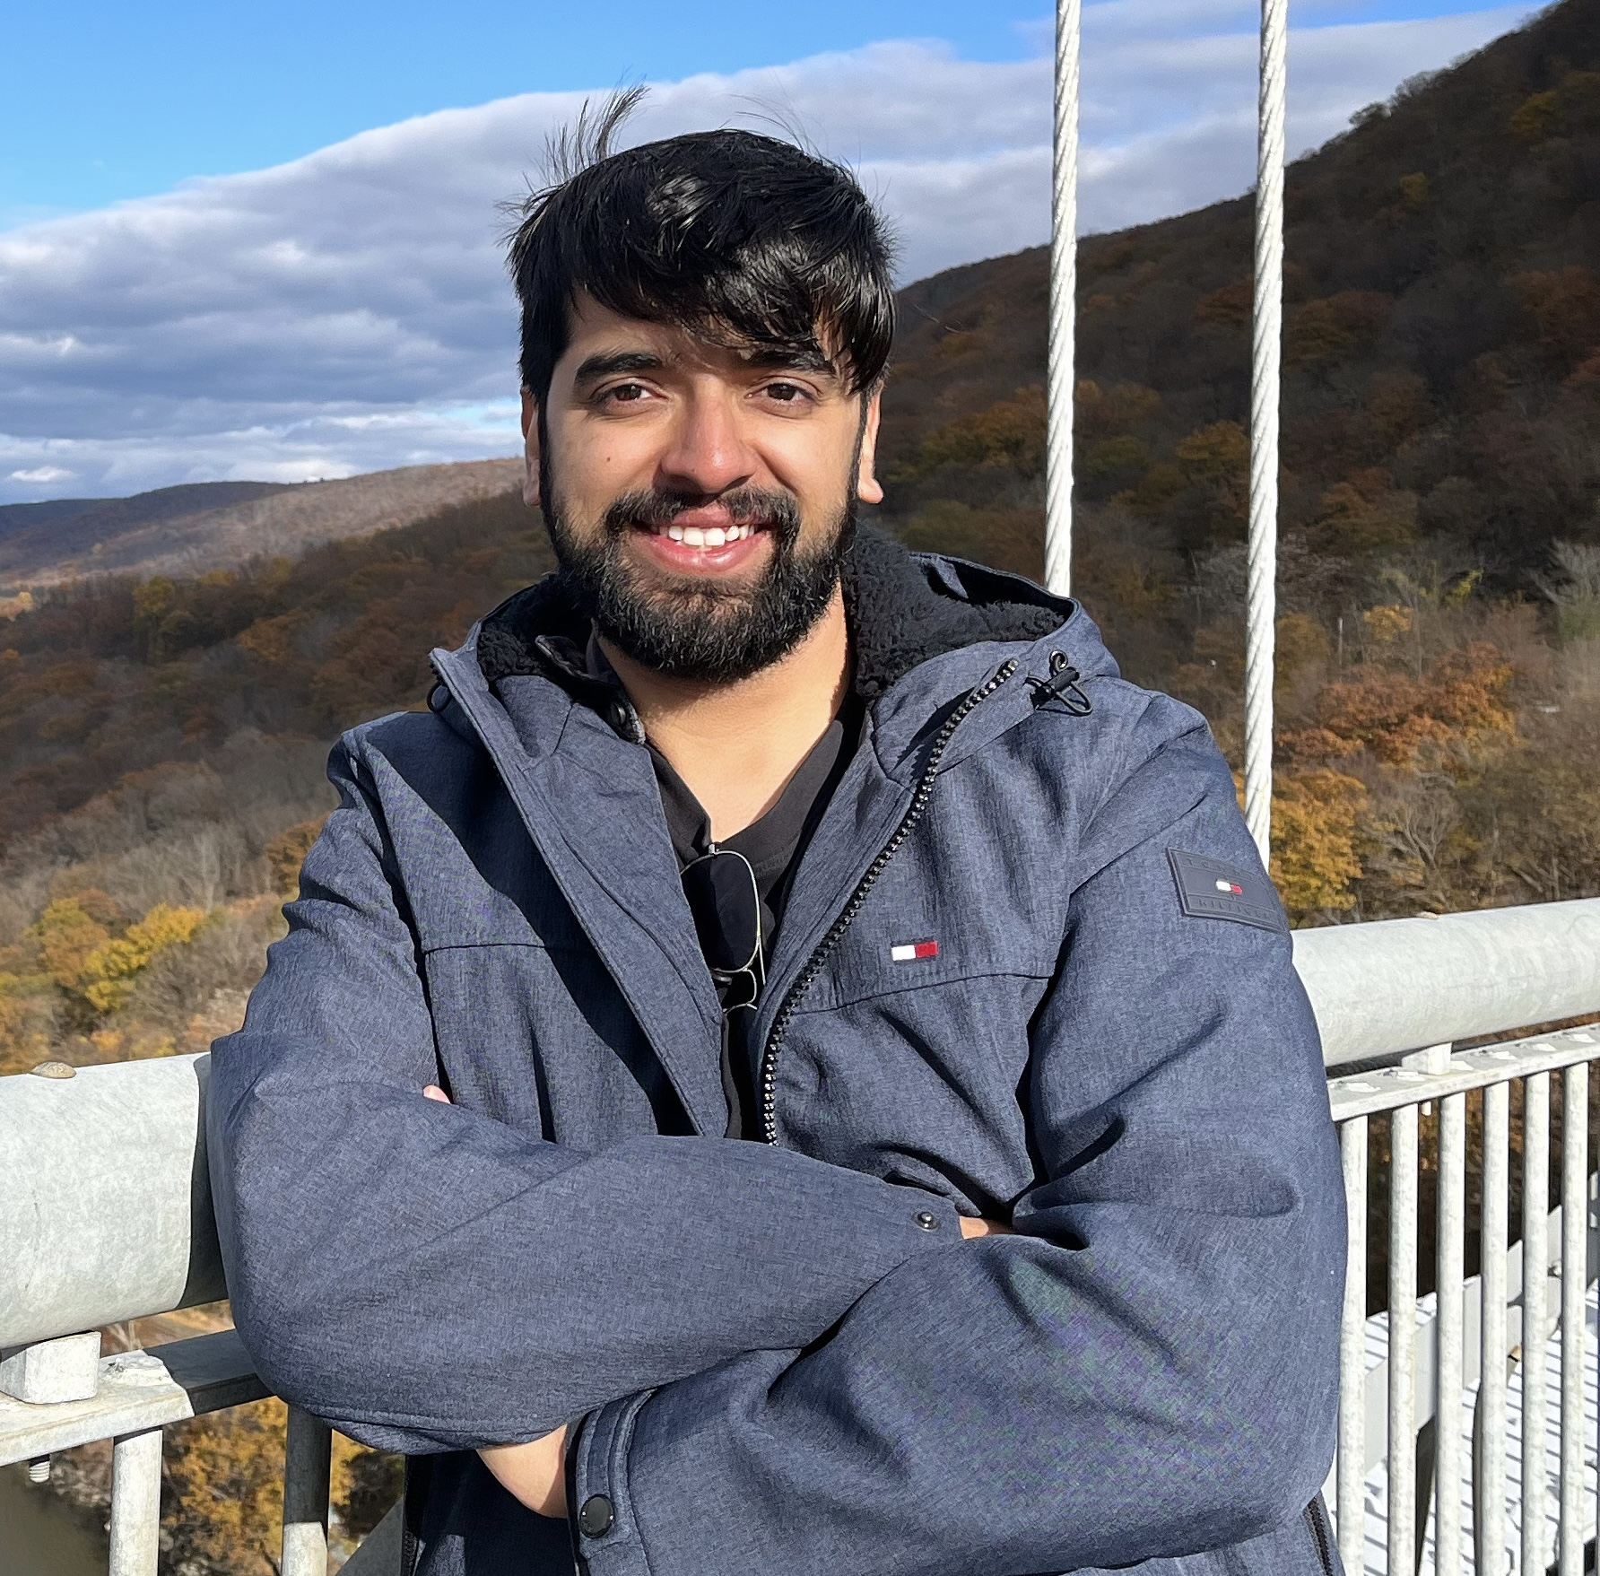
Power Anger
Rushabh Makwana
Vaibhav Thapliyal
Developer Lead
Frontend Developer
Vaibhav.thapliyal6@gmail.com
Backend Developer
Rm36294n@pace.edu

Slide 6
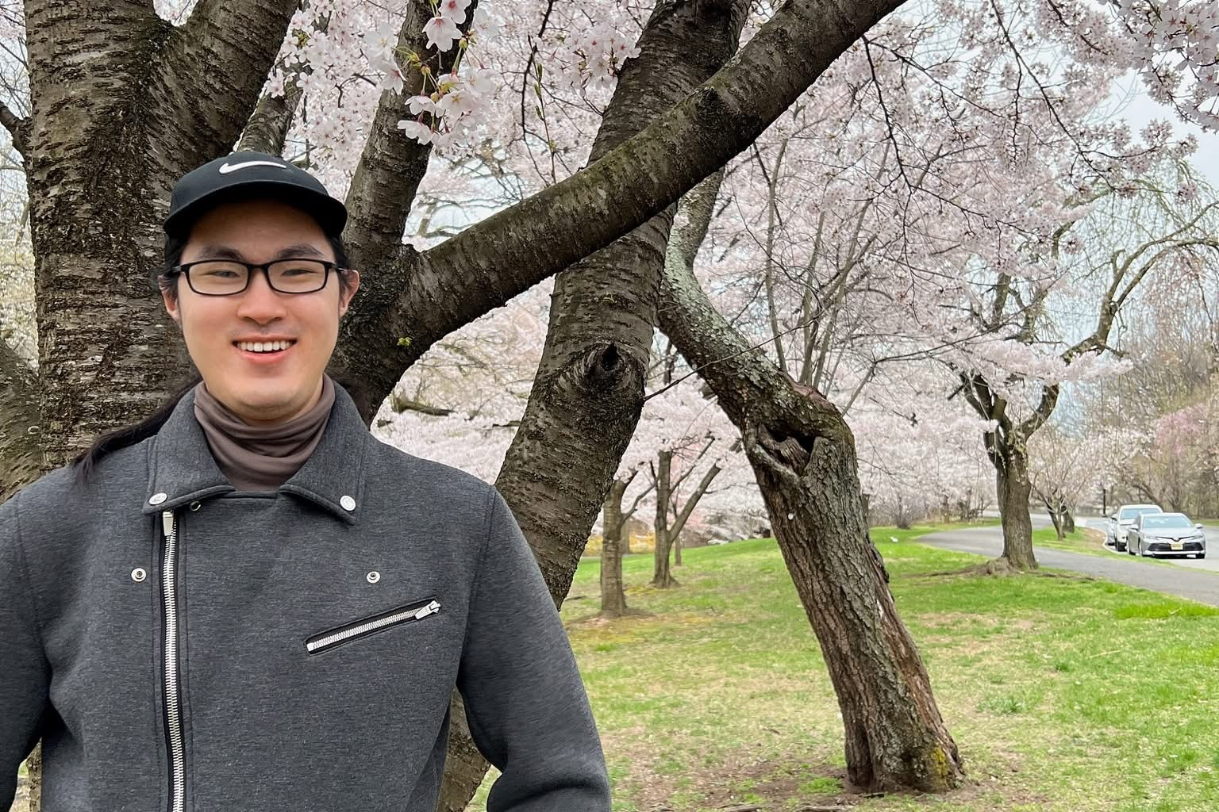
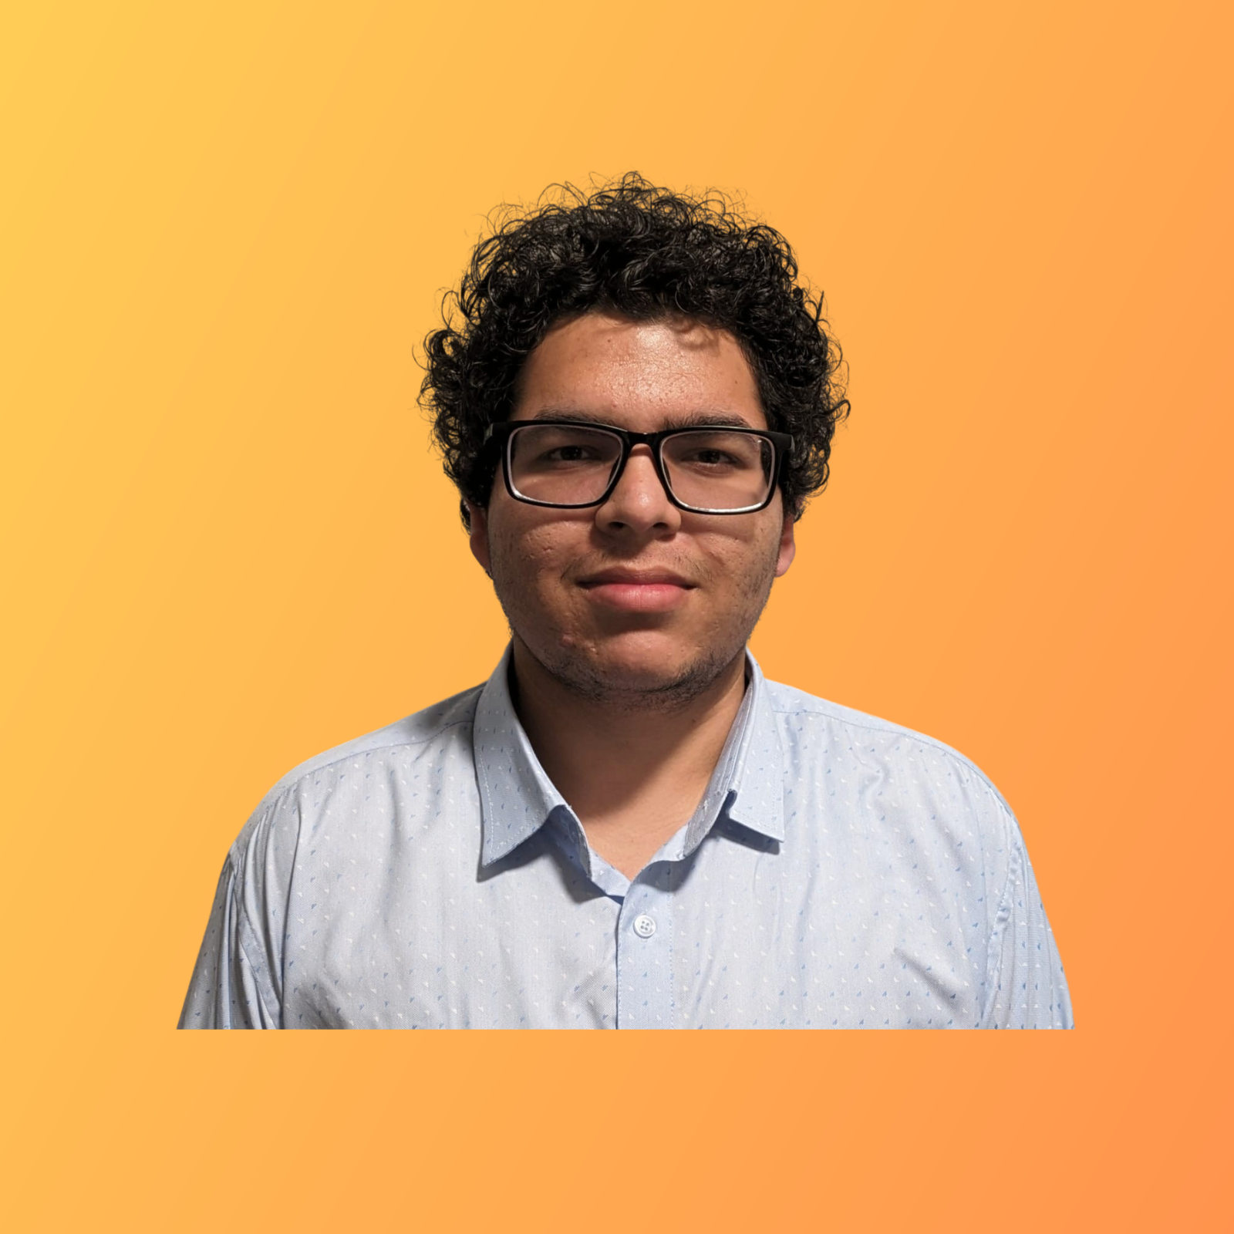
Power Anger
Min Jung
Hrishikesh Shah
Quality Analyst
Mj34564n@pace.edu
Frontend Developer
Hs75142n@pace.edu

Slide 7
Problem Statement
Navigating through everyday environments presents significant challenges for blind and visually impaired individuals., moving vehicles, and the lack of real-time guidance.
Traditional mobility aids like canes and guide dogs, while helpful, often fall short in providing comprehensive and real-time information about obstacles, directions, and surroundings.
This lack of real-time situational awareness can lead to increased risks of accidents and restrict the independence of visually impaired individuals.
Therefore, there is a pressing need for an innovative solution that leverages modern technology to enhance mobility and safety for the visually impaired community.
This project aims to create a web app that uses object detection and voice commands to help blind people navigate safely by warning them about obstacles, giving directions, and describing their surroundings in real time.

Slide 8
Project Description (improved)
Project Name: | GuideSense
Team: | Power Angers
Project Description: | For visually impaired individuals who need assistance navigating independently in urban and outdoor environments, the real-time object detection web app is a computer vision and AI-powered solution that identifies objects, obstacles and crosswalks while providing real-time audio guidance and GPS-based navigation support. Unlike traditional mobility aids or existing navigation apps that lack real-time object detection, our application offers a seamless, intelligent, and accessible way for visually impaired users to navigate confidently.
Benefit Outcomes: | Increased Independence, Enhanced Safety, Improved Mobility, Greater Confidence, Accessibility, and Inclusivity.
GitHub Link: | https://github.com/htmw/2025S-Power-Anger/wiki

Slide 9
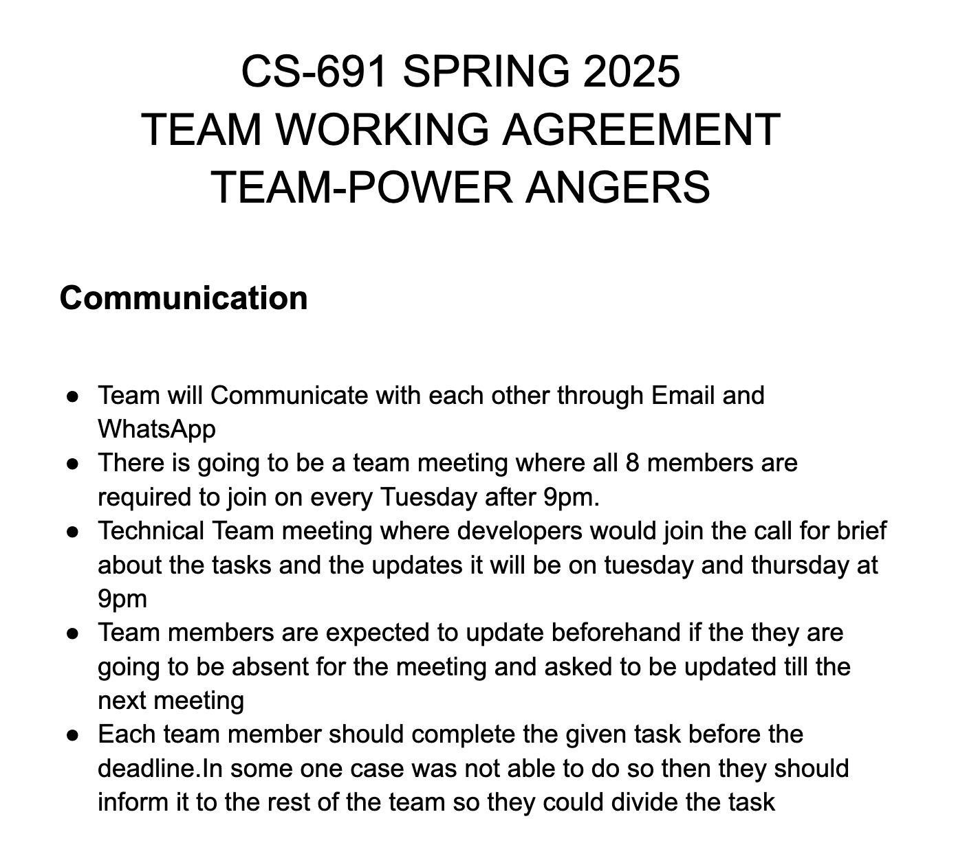
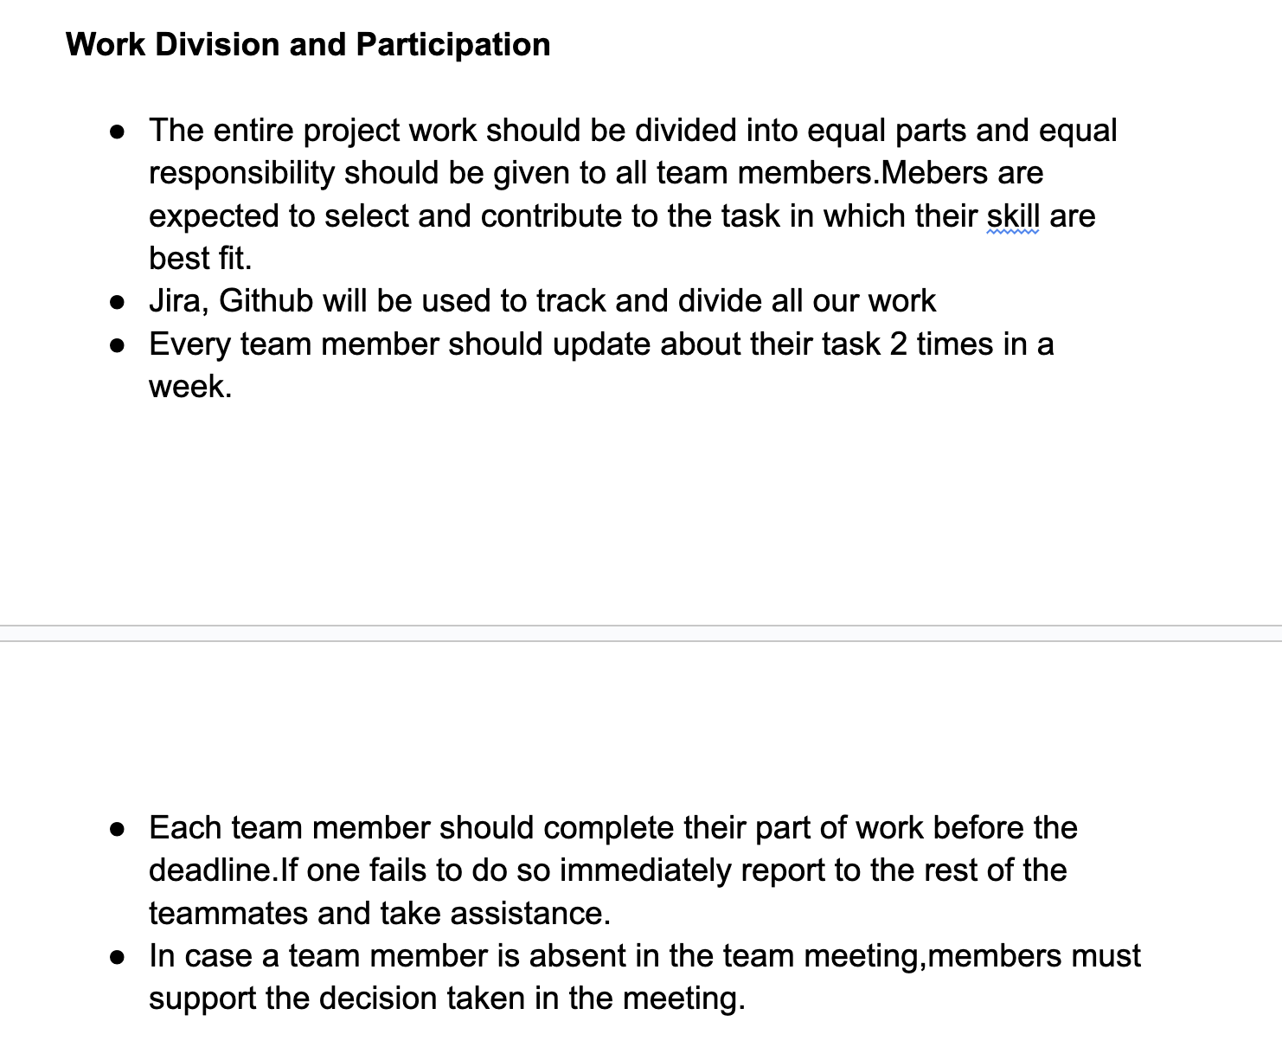
Team Working Agreement

Slide 10
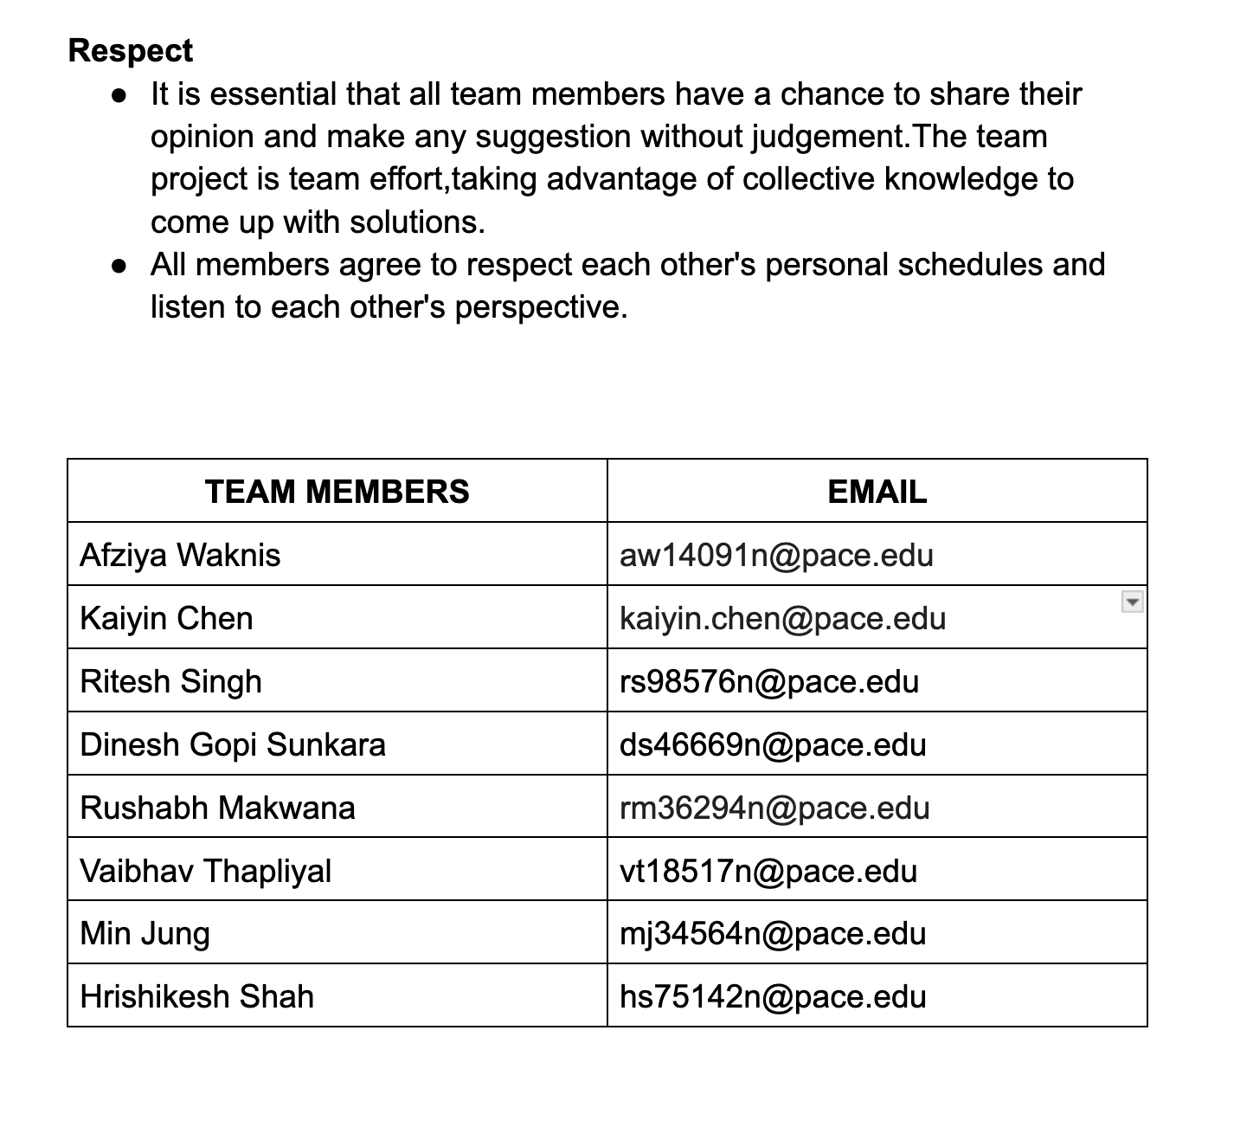
Team Working Agreement

Slide 11

Persona One: The Independent Blind User
Name: Aisha Khan
Age: 32
Occupation: Software Developer (works remotely)
Background: Aisha has been blind since birth. She is highly tech-savvy and relies on assistive technology. She is motivated to use tools that enhance her independence and streamline daily activities.
App Usage Scenario: Aisha wants to use the app for navigation while walking, especially in unfamiliar areas, and identify objects which could be a barrier for seamless tasks.
Needs: Seamless integration with existing assistive technologies (screen readers, voice control), accurate location services, reliable information about accessible routes and environments, and robust privacy features.
Goals: Increased independence, improved access to information, enhanced safety while navigating, and streamlined daily task management.

Slide 12
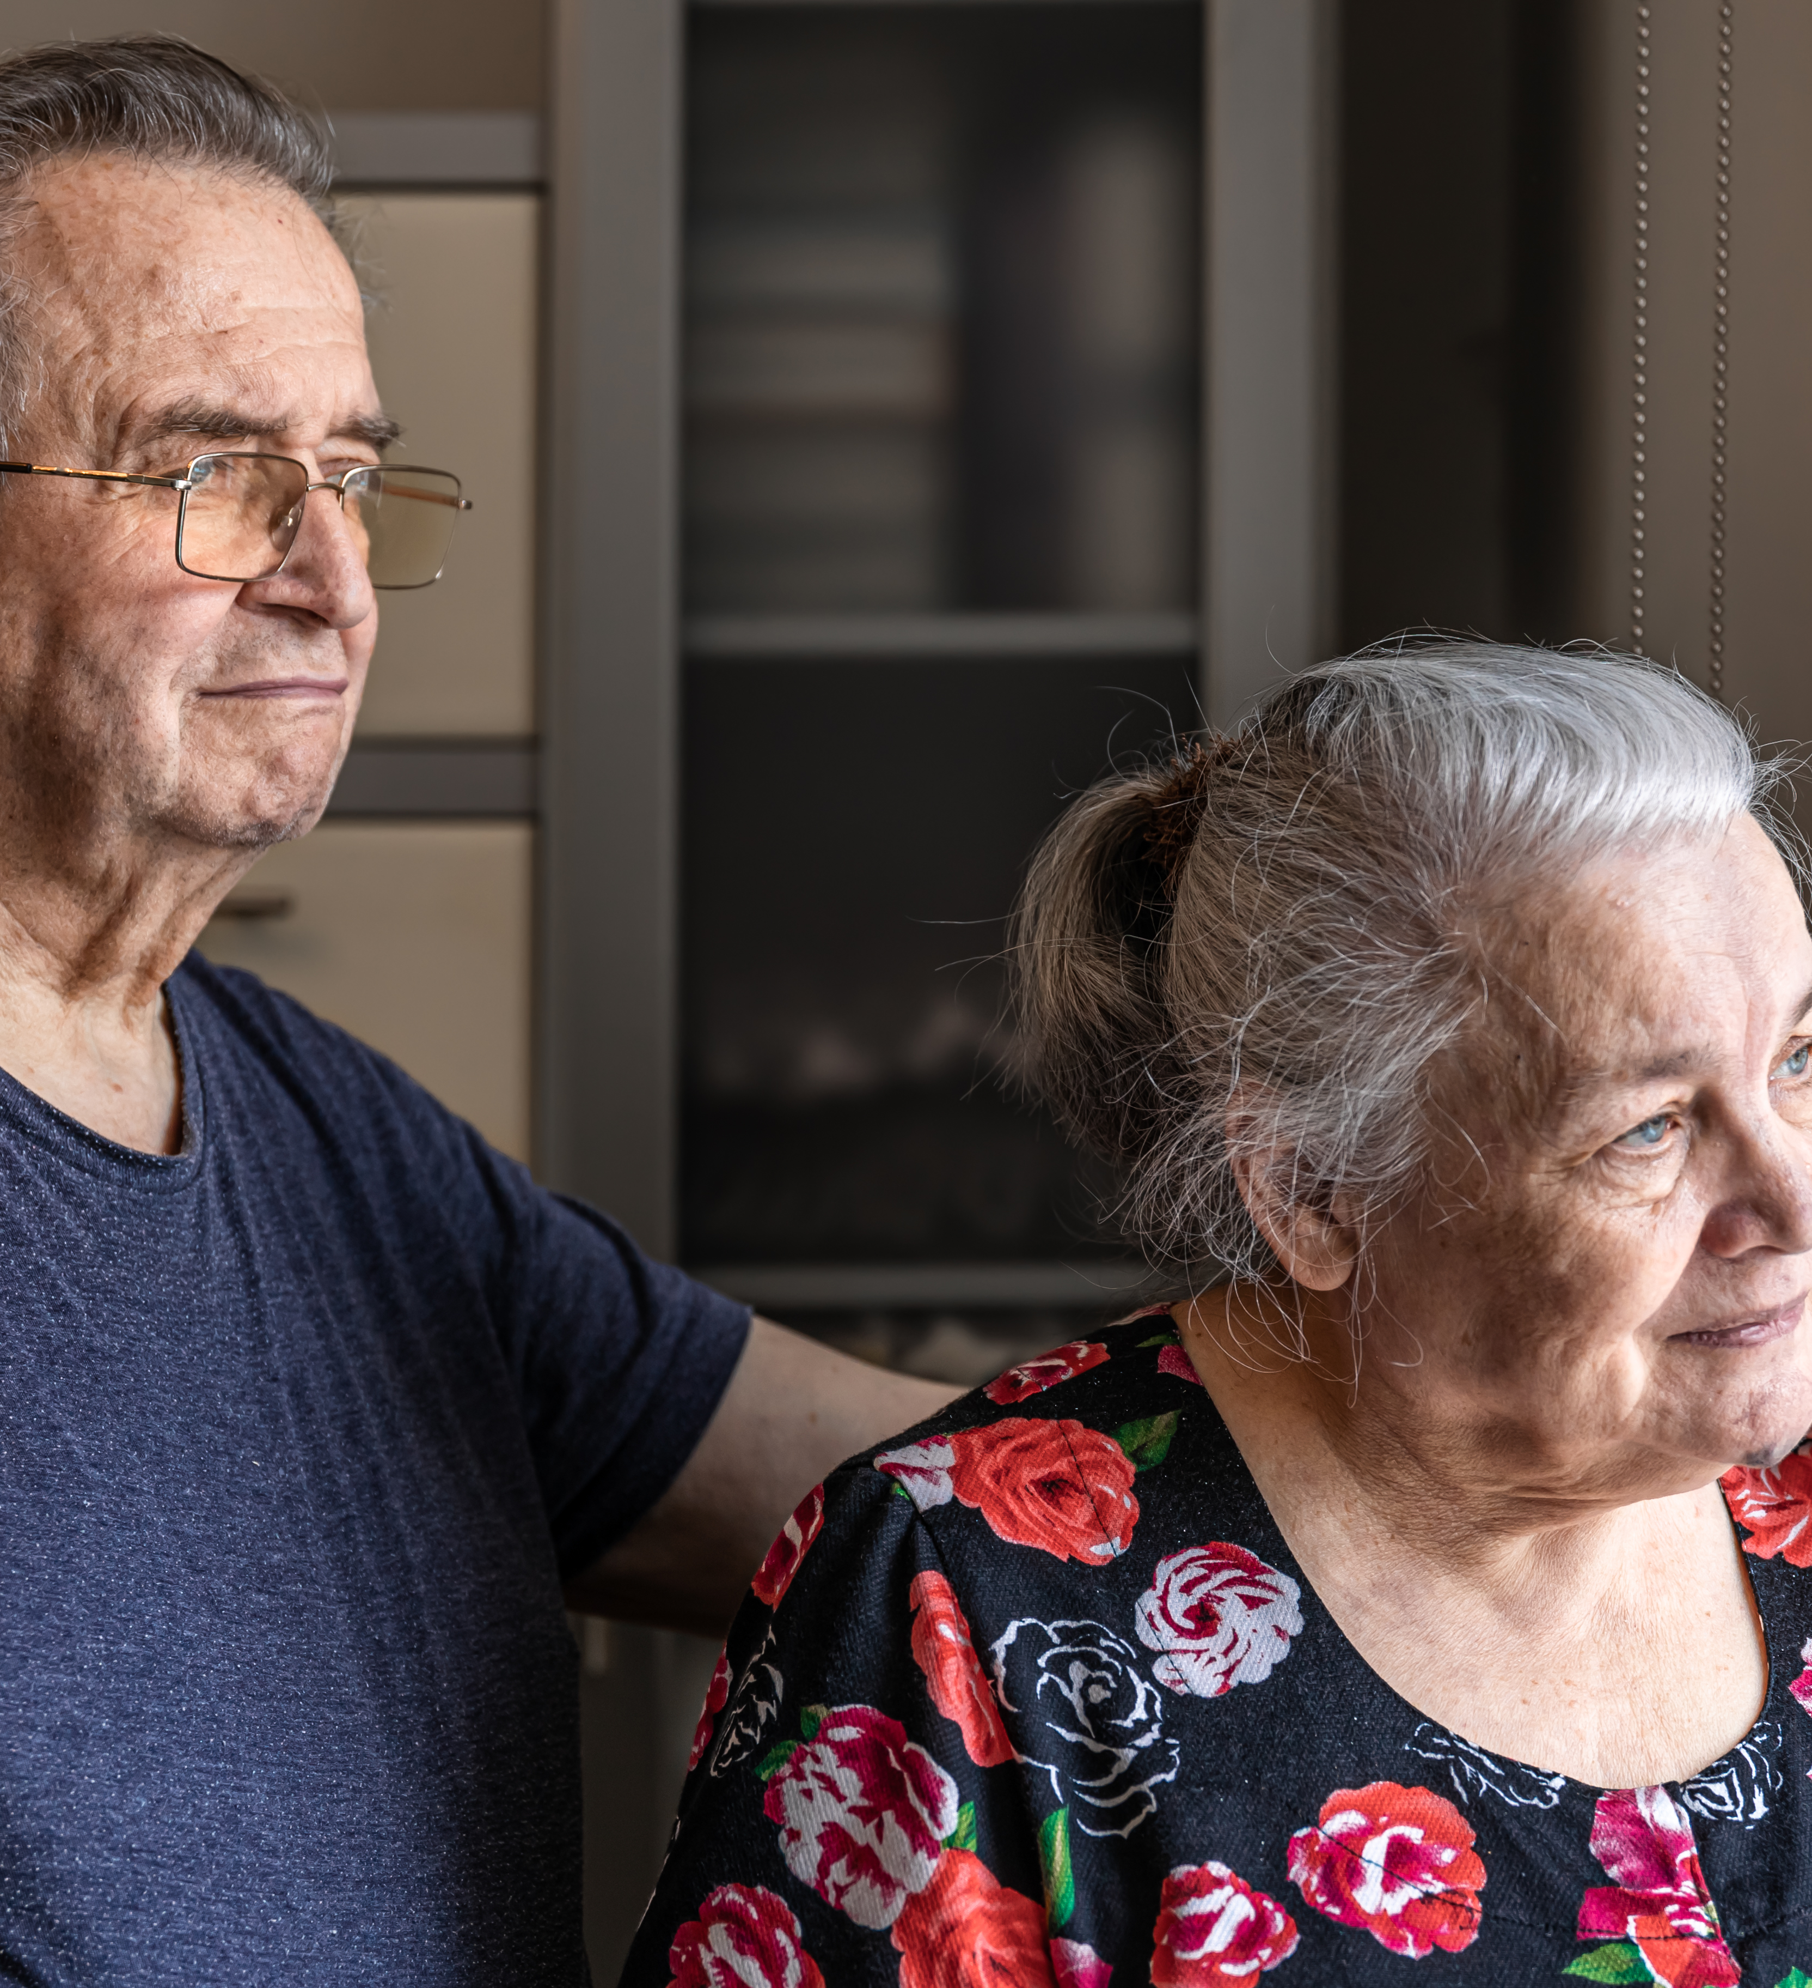
Persona Two: The Concerned Family Member
Name: Robert Chen
Age: 65
Relationship: Son of a visually impaired senior
"I worry about my mother's safety. I hope this app can help me stay connected and ensure she's doing okay."
Background: Robert's mother is losing her vision due to macular degeneration. He lives in a different city and wants to stay connected and provide support remotely.
App Usage Scenario: Robert wants to use the app to track his mother's location (with her consent), receive alerts if she deviates from her usual routes, remotely assist her with tasks like medication reminders, and communicate with her easily through the app's accessible interface.
Needs: User-friendly interface, reliable location tracking (with privacy safeguards), remote assistance features, accessible communication tools, and clear instructions for setup and use.
Goals: Increased peace of mind, improved communication with his mother, ability to provide remote support, and enhanced safety for his visually impaired parent

Slide 13
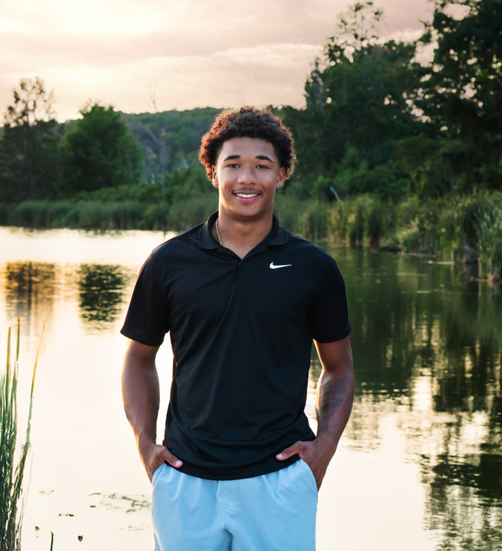
Persona Three : Partially sighted Teenager
Name: David Miller
Age: 16
Background: David has low vision due to a genetic condition. He can see some things with the aid of glasses or magnifiers.
"I want to be able to do the same things my friends do. I hope this app can help me navigate more easily and access information."
App Usage Scenario: David wants to use the app to magnify text and images, identify colors, navigate public transportation, and access audio descriptions of videos and other media. He needs an app that is easily customizable to his specific visual needs.
Needs: Customizable display settings (font size, contrast, color schemes), reliable object and text recognition features, seamless integration with magnification tools, and accessible interface that can be used with limited vision.
Goals: Increased independence, improved access to information, enhanced social participation, and greater confidence in navigating the world.

Slide 14
MVP
A client (web browser) connects to the server and sends a WebRTC offer
The server sets up a peer connection, processes the offer, and sends back an answer
When video starts streaming from the client, each frame is: - Received by the server - Processed through YOLO (object detection) - Enhanced with visual indicators (boxes around objects) - Sent back to the client in real-time

Slide 15










Technologies & Tools (improved)
NodeJs: RunTime
React: Frontend
Python: Object Detection
Clerk: Authentication
MongoDB: Database
AWS: Deployment
Jira: Project Management
GitHub: Code Versioning
OneDrive: File Sharing
IdeaBoardz: Sprint Retrospective

Slide 16
AI Model
YOLO, which stands for ‘You Only Look Once,’ is a state-of-the-art object detection model known for its real-time speed and accuracy.
Real-time Speed: Processes the entire image in a single pass, making it one of the fastest models for object detection.
Grid-Based Detection: Divides the image into a grid, with each cell responsible for detecting objects within it.
Accurate Bounding Boxes: Predicts precise bounding boxes and confidence scores for each detected object.
Pre-trained on COCO: Leverages the massive COCO dataset (80 object categories, 200,000+ images) for robust and accurate general object detection
Refined Results: Uses Non-Maximum Suppression (NMS) to eliminate overlapping detections and ensure only the most accurate results are shown.

Slide 17
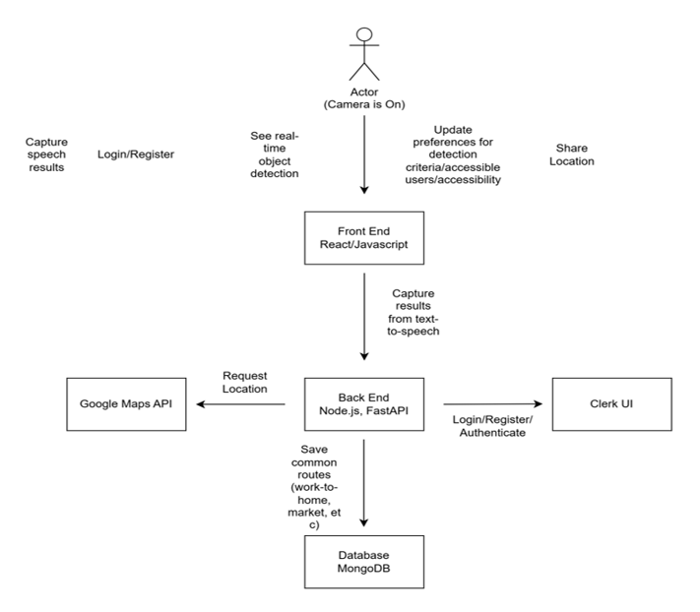
Architecture Diagram

Slide 18
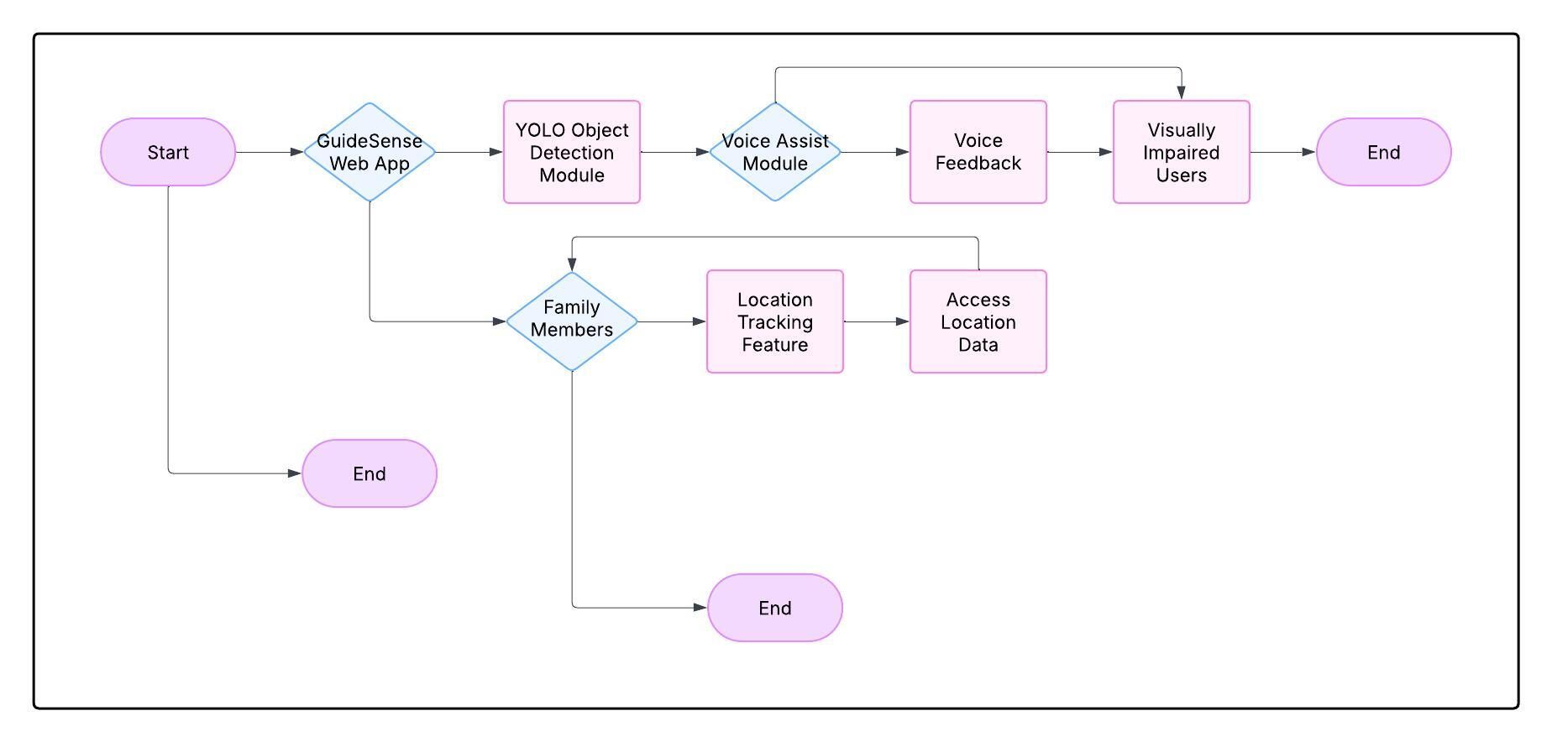
Context Diagram

Slide 19
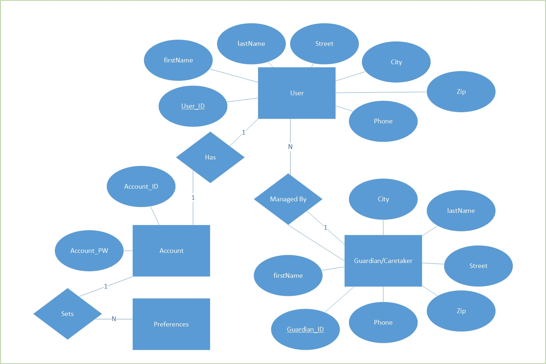
ER Diagram(improved)

Slide 20
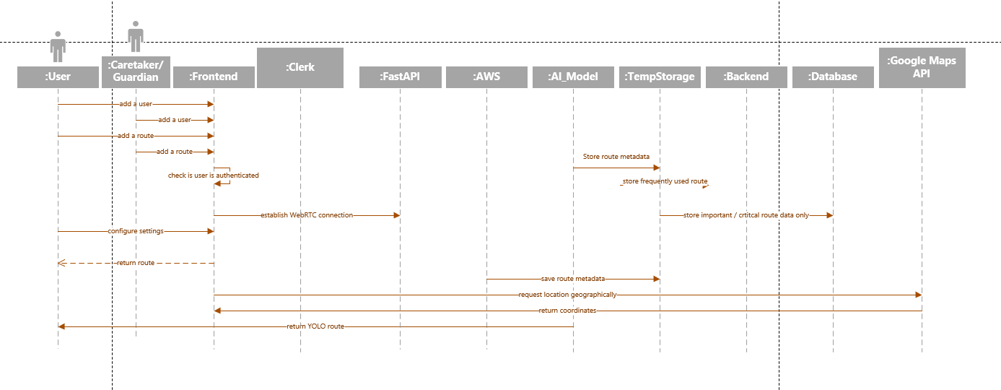
Sequence Diagram

Slide 21
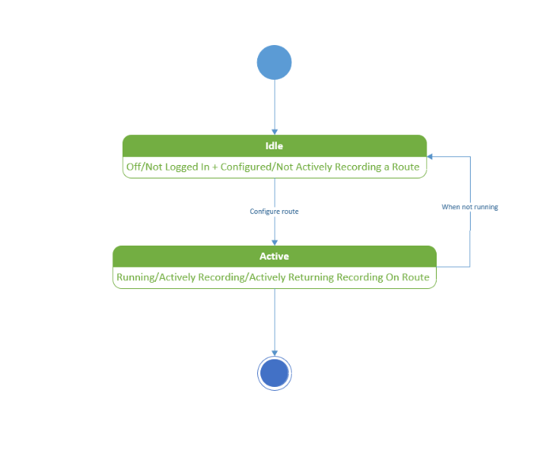
State Diagram

Slide 22
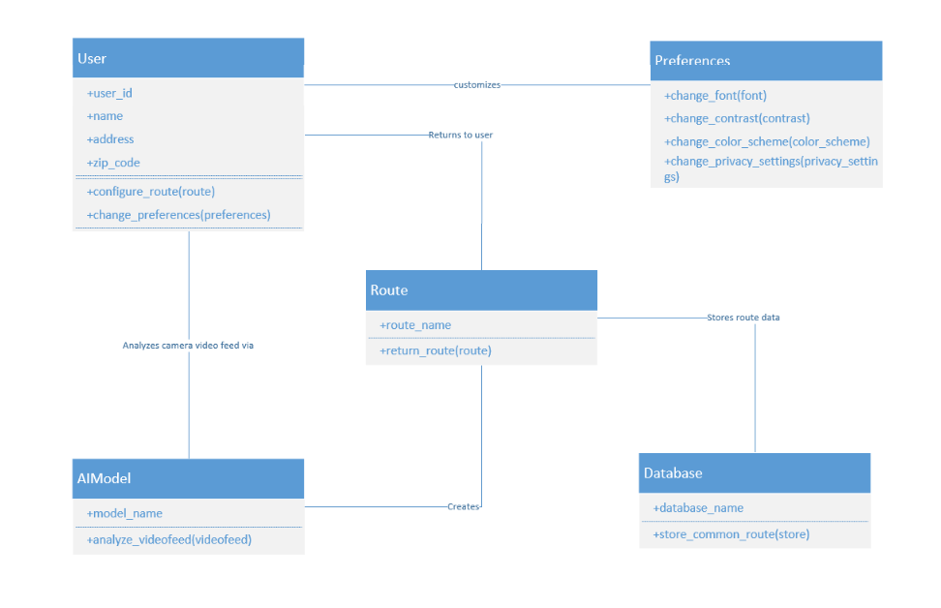
Class Diagram

Slide 23
Sprint 1 Recap
1
2
3
Implemented YOLO Module
Implemented Authentication
Designed application diagrams
4
Established services for database and server
5
Implemented Google Map API for route detection

Slide 24
Product Backlog
ID | Sprint | User Story / Technical Story | Acceptance Criteria | SP
US1 | 2 | As a visually impaired user, I want to receive real-time alerts when objects are detected through my phone camera | The FastAPI backend should process frames using the YOLO model and return a JSON object with detected obstacles or important objects (e.g., door, chair, or pedestrian), ensuring minimal delay for real-time assistance. | 5
US2 | 2 | As a visually impaired user, I want an intuitive interface that allows me to easily capture images using my phone camera, so that the system can analyze the surroundings and help me navigate safely. | The application must provide an accessible interface that allows visually impaired users to easily capture images through the phone camera and receive real-time audio feedback on detected objects. | 8
US3 | 2 | As a visually impaired user, I want the system to describe detected objects in my surroundings through text-to-speech, so that I can receive real-time auditory feedback and safely navigate my environment. | The system should accurately identify objects in the user's surroundings and provide clear, real-time auditory descriptions through text-to-speech, ensuring the user can understand and navigate their environment safely | 8

Slide 25
Product Backlog
ID | Sprint | User Story / Technical Story | Acceptance Criteria | SP
US4 | 2 | As a user, I want to store my data in the app’s frontend and see the results reflected immediately so that I can interact with the application in real-time and track my information. | the frontend should allow users to store and display data in real-time, reflecting changes immediately in the app interface. | 3
US5 | 1 | As a user, I want to securely sign up, log in, and manage my account so that I can access personalized features within the app. | The user should be able to securely sign up, log in, manage their account, reset their password, and maintain their session, with proper error handling and redirection after authentication using Clerk | 8
US6 | 0 | As a user, I want to enter a source and destination and receive navigation directions so that I can easily find the best route to my destination. | The user should be able to input a source and destination address, and the system should display the best route using Google Maps, providing turn-by-turn navigation with estimated time of arrival and distance. | 8

Slide 26
Product Backlog
ID | Sprint | User Story / Technical Story | Acceptance Criteria | SP
TS1 | 0 | As a developer, I need to write test cases for Sprint 0 to ensure the implemented features are working as expected and meet the acceptance criteria. | All user stories and technical requirements from Sprint 1 should have corresponding test cases that cover positive, negative, and edge case scenarios. | 5
TS2 | 1 | As a developer, I need to write test cases for Sprint 1 to ensure the implemented features are working as expected and meet the acceptance criteria. | All user stories and technical requirements from Sprint 2 should have corresponding test cases that cover positive, negative, and edge case scenarios. | 5
TS3 | 2 | As a developer, I need to write test cases for Sprint 2 to ensure the implemented features are working as expected and meet the acceptance criteria. | All user stories and technical requirements from Sprint 3 should have corresponding test cases that cover positive, negative, and edge case scenarios. | 5
TS4 | 3 | As a developer, I need to write test cases for Sprint 3 to ensure the implemented features are working as expected and meet the acceptance criteria. | All user stories and technical requirements from Sprint 4 should have corresponding test cases that cover positive, negative, and edge case scenarios. | 5

Slide 27
Product Backlog
ID | Sprint | User Story / Technical Story | Acceptance Criteria | SP
TS4 | 2 | As a developer, I need to write a technical paper documenting the methodology, findings, and outcomes of our project so that it can be shared with stakeholders, academic peers, or for publication purposes. | The technical paper should comprehensively document the project's problem, methodology, results, analysis, and conclusions, following a clear, structured format with proper citations and adhering to the required submission guidelines. | 5
TS5 | 1 | As a developer, I need to set up the MongoDB database according to the ER diagram so that the data structure aligns with the application requirements, ensuring efficient storage and retrieval of user information. | The database should be set up according to the ER diagram with proper schema, indexing, and relationships | 5
TS6 | 2 | As a developer, I need to document the API endpoints and integrations for FastAPI, YOLO object detection, and Google Maps so that the team can easily understand how to interact with the services and ensure smooth integration. | The API documentation should clearly describe all FastAPI endpoints, YOLO object detection integration, Google Maps functionality, include example requests and responses, and provide authentication details, error codes, and troubleshooting guidelines. | 5

Slide 28
Product Backlog
ID | Sprint | User Story / Technical Story | Acceptance Criteria | SP
TS7 | 0 | As a developer, I need to research and evaluate different AI models for real-time object detection and explore WebRTC and other methods for connecting the backend and frontend, so that we can select the most suitable technologies for our project’s requirements. | The research should evaluate various AI models for real-time object detection and communication methods like WebRTC, comparing performance, scalability, security, and deployment requirements, and provide a recommendation based on the project's needs. | 5
TS8 | 0 | As a developer, I need to create an diagrams(Architecture, Sequence, Class, ER, State, Context) for the entire product, which includes all core components, services, and interactions such as the frontend, backend, external APIs, database, and third-party integrations, so that the overall structure and flow of the system are clearly understood and can be implemented effectively. | The architecture diagram should clearly represent all major components (functional and non-functional) of the product, their interactions, data flow, and error handling mechanisms, using a standard tool for easy understanding and team review. | 13

Slide 29
Product Backlog
ID | Sprint | User Story / Technical Story | Acceptance Criteria | SP
TS9 | 0 | As the Project Manager, I want to ensure seamless coordination between technical components and stakeholders, So that the system meets both user needs and technical specifications | The system should facilitate regular communication between stakeholders and the development team, track progress against project goals, ensure alignment between user needs and technical specifications, and maintain clear documentation for all key technical components and requirements | 5
TS10 | 2 | As a Developer, I want to review and update the diagrams | Diagrams should be upto date and should be reviewed with the team | 1
TS11 | 3 | As a user, I want to enable to add friend function that allow share location in the future. | User able to share their location to other users for tracking purpose.

Slide 30
Sprint 2 Backlog
ID | User Story / Technical Story | Acceptance Criteria | SP | status
US1 | As a visually impaired user, I want to receive real-time alerts when objects are detected through my phone camera | The FastAPI backend should process frames using the YOLO model and return a JSON object with detected obstacles or important objects (e.g., door, chair, or pedestrian), ensuring minimal delay for real-time assistance. | 5 | Completed
US2 | As a visually impaired user, I want an intuitive interface that allows me to easily capture images using my phone camera, so that the system can analyze the surroundings and help me navigate safely. | The application must provide an accessible interface that allows visually impaired users to easily capture images through the phone camera and receive real-time audio feedback on detected objects. | 8 | Completed
US3 | As a visually impaired user, I want the system to describe detected objects in my surroundings through text-to-speech, so that I can receive real-time auditory feedback and safely navigate my environment. | The system should accurately identify objects in the user's surroundings and provide clear, real-time auditory descriptions through text-to-speech, ensuring the user can understand and navigate their environment safely | 8 | Completed

Slide 31
Sprint 2 Backlog
ID | User Story / Technical Story | Acceptance Criteria | SP | status
TS6 | As a developer, I need to document the API endpoints and integrations for FastAPI, YOLO object detection, and Google Maps so that the team can easily understand how to interact with the services and ensure smooth integration | The API documentation should clearly describe all FastAPI endpoints, YOLO object detection integration, Google Maps functionality, include example requests and responses, and provide authentication details, error codes, and troubleshooting guidelines. | 5 | Completed
TS10 | As a Developer, I want to review and update the diagrams | Diagrams should be upto date and should be reviewed with the team | 1 | Not Completed
TS4 | As a developer, I need to write a technical paper documenting the methodology, findings, and outcomes of our project so that it can be shared with stakeholders, academic peers, or for publication purposes. | The technical paper should comprehensively document the project's problem, methodology, results, analysis, and conclusions, following a clear, structured format with proper citations and adhering to the required submission guidelines. | 5 | Completed

Slide 32
Sprint 2 Backlog
ID | User Story / Technical Story | Acceptance Criteria | SP | status
TS3 | As a developer, I need to write test cases for Sprint 2 to ensure the implemented features are working as expected and meet the acceptance criteria. | All user stories and technical requirements from Sprint 3 should have corresponding test cases that cover positive, negative, and edge case scenarios. | 5 | Completed
US4 | As a user, I want to store my data in the app’s frontend and see the results reflected immediately so that I can interact with the application in real-time and track my information. | the frontend should allow users to store and display data in real-time, reflecting changes immediately in the app interface. | 2 | Completed

Slide 33
Test Cases
ID | Story ID | Test Case | Expected Result | Status
1 | US1 | Capture a video using the phone camera with an object present. | The system should detect the object and provide a real-time response indicating the presence and type of object. | Passed
2 | US1 | Capture a video using the phone camera with no objects present. | The system should not detect any object | Passed
3 | US1 | Move the phone to capture different objects within the camera’s view. | The system should continuously detect and alert the user in real time, updating the alerts as new objects come into view. | Passed
4 | US2 | The user opens the web app, accesses the camera feed, and points the camera at their surroundings. | The user should be able to smoothly activate the camera feed. | Passed
5 | US3 | The user opens the app, points the camera at an object, and the system detects the object in real-time. | The system should describe the detected object through text-to-speech, providing the user with real-time auditory feedback about the object’s type and location. | Partially working

Slide 34
Test Cases
ID | Story ID | Test Case | Expected Result | Status
6 | US4 | The user enters/updates data into the app’s frontend and submits it. | The data should be immediately reflected in the app's interface, with updated information displayed in real-time without requiring a page reload. | Passed
7 | US5 | The user attempts to sign up with valid credentials | The system should successfully create the account, and the user should receive a confirmation message or be redirected to the login page. | Passed
8 | US5 | The user attempts to log in with valid credentials | The system should authenticate the user and allow them to access personalized features within the app. | Passed
9 | US5 | The user attempts to log in with invalid credentials | The system should show an error message indicating invalid credentials and prevent access to the app. | Passed
10 | US6 | The user enters a valid source and destination address and requests directions. | The system should display the best route with turn-by-turn navigation directions, along with the estimated time of arrival and distance. | Passed

Slide 35
Test Cases
ID | Story ID | Test Case | Expected Result | Status
11 | US6 | The map renders correctly on the screen | The user should get map rendered on the screen and must be ready to input navigation through input fields. | Passed
12 | US6 | The user should go to desired location through search field and auto sugestion | The system is helping user to get to desired location suggested by auto suggestion from google Maps API. | Passed
13 | US6 | The route should be calculated accurately | The accurate route is provided to the user. | Passed

Slide 36
Sprint 2 – Burndown Chart
Committed 39 story points and completed 38 story points during Sprint 2.
Notes:
Sprint burndown was completed as shown above. The total sprint commitment was 45 total story points. All issues in the sprint were completed.

Slide 37
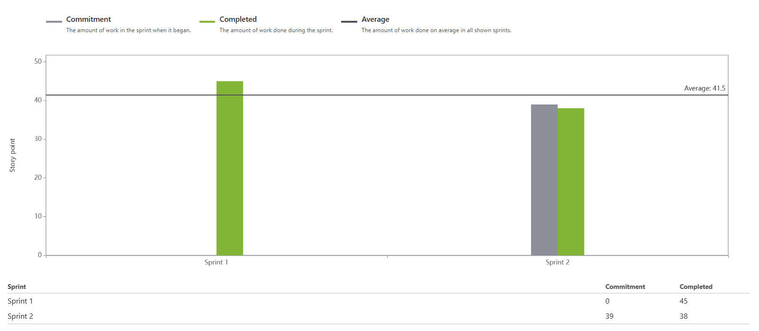
Sprint 2 – Team Velocity & Committed Ratio
Out of a total 39 committed story points, 38 story points were completed. The committed ratio is 97%.

Slide 38
Retrospective – Sprint 2
What went well?
What need to improve?
Action Items
Everyone was updating their work on Jira on time
We started working on all aspects of the project including Technical Paper, API documentation, Test Cases, Product backlog and implementation.
We started the sprint on time, because of that we are on track to finish the project
We are working individually more, so we need to find more time to integrate and collaborate.
Manage your schedule better for standup meetings.
we need to ask for help from team-mates without hesitation and well before deadline
We need to focus more on finishing individual deadlines we set for our tickets.
We can setup more frequent calls for code integration, discussions on technical paper and documentation
Monitor your calendars better and add these meetings to your calendar.
Set alerts for these meetings
We do not need to over commit in sprint planning
Setup a new meeting for doubt sessions.

Slide 39
Sprint 3 – Sprint Planning
ID | User Story / Technical Story | Acceptance Criteria | SP
TS12 | As a developer, I need to create an AWS account for the project so that we can deploy and host backend services, machine learning models, and other cloud-based components in a secure and scalable environment. | An AWS account should be successfully created, with access credentials securely stored and shared with authorized team members. | 2
TS13 | As a developer, I need to deploy the backend and model code on an AWS EC2 instance so that the application can run continuously on the cloud and handle real-time requests from users. | The backend and model code should be successfully deployed and running on the EC2 instance, accessible via the instance’s public IP or domain, and verified through test requests. | 8
TS14 | As a developer, I need to create a comprehensive deployment and installation manual for the project so that other team members and future developers can easily set up the environment, deploy the application, and maintain the system. | The manual should include clear, step-by-step instructions for environment setup, dependencies installation, code deployment, and running the application, and should be accessible to the entire team. | 8

Slide 40
Sprint 3 – Sprint Planning
ID | User Story / Technical Story | Acceptance Criteria | SP
TS15 | As a developer, I need to deploy the project’s database on an AWS RDS server so that we can ensure secure, scalable, and managed database access for our application across all environments. | The database should be successfully created and deployed on the RDS server, with appropriate security groups, credentials configured, and connectivity verified from the application backend. | 3
US7 | As a visually impaired user, I want the app’s interface to be fully connected with the backend services so that I can receive real-time updates about my surroundings, store my data, and access personalized features seamlessly as I navigate through the app. | The frontend and backend should work together to provide real-time object detection, user-specific responses, and data storage, with all core features functioning smoothly and verified end-to-end through user interaction. | 8
US8 | As a user, I want a simple and accessible UI to input my source and destination so that I can easily receive navigation directions using Google Maps and move safely and independently. | The UI should allow users to enter source and destination locations, and upon submission, display route information and initiate navigation using Google Maps integration in an accessible format. | 5

Slide 41
Sprint 3 – Sprint Planning
ID | User Story / Technical Story | Acceptance Criteria | SP
TS4 | As a developer, I need to write test cases for Sprint 3 to ensure the implemented features are working as expected and meet the acceptance criteria. | All user stories and technical requirements from Sprint 4 should have corresponding test cases that cover positive, negative, and edge case scenarios. | 5
TS16 | As a developer, I need to draft a technical paper that documents the design, architecture, implementation details, challenges faced, and results of the project so that we can clearly present our work for academic or professional review. | The technical paper should include sections on problem statement, methodology, system architecture, technology stack, implementation details, challenges, results, and future work, and it should be well-structured and ready for submission or presentation. | 5
US9 | As a user, I want to be able to connect with other users and grant them access to control my app temporarily, so that they can assist me in navigating or using certain features remotely when I need help. | The system should allow a user to securely share access with a trusted user, enabling them to view and interact with key controls in real-time, with the ability to revoke access at any time. | 5

Slide 42
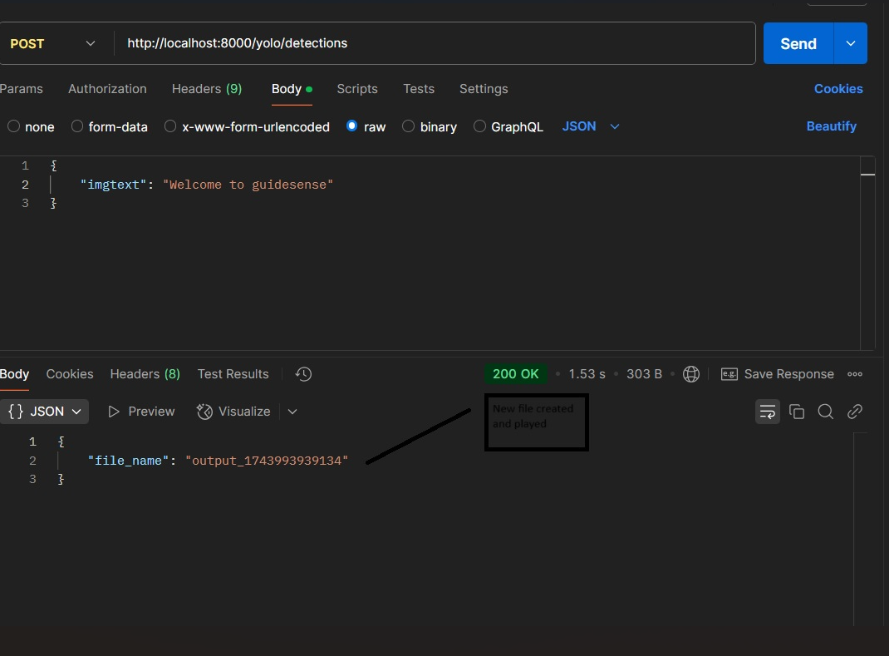
Sprint 2 – Project Demo

Slide 43
https://github.com/htmw/2025S-Power-Anger/wiki
Project Wikipage Link

Slide 44
Live Application Demo

